Slide 1
C. difficile in mouse cecal contents
University of Michigan
Matthew Jenior
MICH-02-16VW DEC 12, 2016
Gregory R. Wagner, PhD

Slide 2
Study Overview
Study Objective
The goal of this study was to compare the metabolomic profiles in cecal fluid from non-infected (NI) mice and from mice infected with Clostridium difficile (C. diff), both with and without various antibiotic treatments.
Study Design
This 81 sample study examined global metabolic profiles in mouse cecal contents from non-infected mice and mice infected with C. difficile. Mice received no treatment or antibiotic treatment with Cefoperazone, Clindamycin, or Streptomycin. Included as controls are germ-free mice, either uninfected or infected (no antibiotic). Global metabolic profiles were determined from the experimental groups outlined in the table below.
Group | Description | n
Germ-Free NI, No TX | Cecal contents from germ-free mice, with no infection or treatment | 9
Germ-Free C. diff, No TX | Cecal contents from germ-free mice, with C. diff infection and no treatment | 9
Conv NI, No TX | Cecal contents from conventional mice, with no infection or treatment | 9
Conv NI, Cef | Cecal contents from conventional mice, with no infection and treated with Cefoperazone | 9
Conv C. diff, Cef | Cecal contents from conventional mice, with C. diff infection and treated with Cefoperazone | 9
Conv NI, Clinda | Cecal contents from conventional mice, with no infection and treated with Clindamycin | 9
Conv C. diff, Clinda | Cecal contents from conventional mice, with C. diff infection and treated with Clindamycin | 9
Conv NI, Strep | Cecal contents from conventional mice, with no infection and treated with Streptomycin | 9
Conv C. diff, Strep | Cecal contents from conventional mice, with C. diff infection and treated with Streptomycin | 9

Slide 3
Statistical Summary
 | Statistical Comparisons
 | Welch's Two-Sample t-Test
Statistically Significant Biochemicals | Non-Infected |  |  |  | C. diff Non-Infected
 | Conv No TX | Cef | Clinda | Strep | Cef | Clinda | Strep | Germ-Free No TX | Cef | Clinda | Strep
 | Germ-Free No TX | No TX | No TX | No TX |  |  |  |  | No TX | No TX | No TX
Total biochemicals p≤0.05 | 556 | 525 | 544 | 509 | 167 | 64 | 115 | 318 | 560 | 541 | 507
Biochemicals (↑↓) | 375 | 181 | 198 | 327 | 169 | 375 | 166 | 343 | 31 | 136 | 23 | 41 | 51 | 64 | 198 | 120 | 184 | 376 | 163 | 378 | 156 | 351
Total biochemicals 0.05<p<0.10 | 37 | 33 | 37 | 38 | 82 | 32 | 64 | 44 | 36 | 34 | 42
Biochemicals (↑↓) | 24 | 13 | 6 | 27 | 7 | 30 | 9 | 29 | 10 | 72 | 18 | 14 | 32 | 32 | 30 | 14 | 10 | 26 | 13 | 21 | 22 | 20
From a total of 727 named biochemicals in mouse cecal contents.

Slide 4
Data Display
Box Plot Legend
Metabolite Name
Germ-Free NI, No TX
Germ-Free C. diff, No TX
Scaled Intensity
Conv NI, No TX
Conv NI, Cef
Conv C. diff, Cef
Conv NI, Clinda
Conv C. diff, Clinda
Conv NI, Strep
Conv C. diff, Strep
Group

Slide 5
Principle Component Analysis
Germ-free,
No Abx
Germ-Free,
infected
Germ-Free, not
infected (NI)
Infected, Cefo
Infected, Clinda
Infected, Strep
NI, No Abx
Not infected,
No Abx
NI, Cefo
NI, Clinda
+Abx
NI, Strep

Slide 6
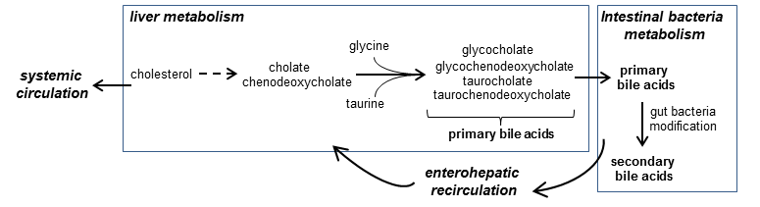
Abx-related Changes in Microbiome-derived Metabolites

Slide 7
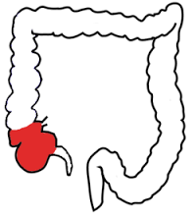
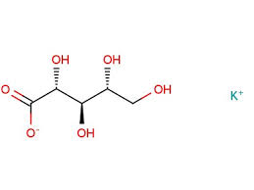

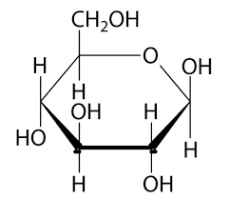

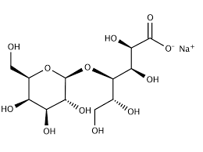

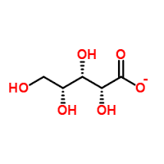
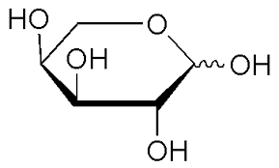
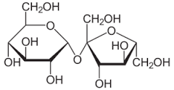
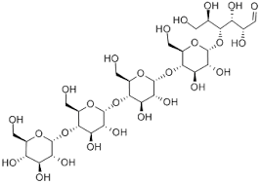
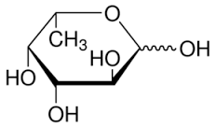
Abx-induced Changes in Carbohydrates and Sugar Alcohols
cecal contents

Slide 8
Antibiotic-specific Differences in Carbohydrates and Sugar Alcohols
cefoperazone-specific changes
clindamycin-specific changes

Slide 9
CDI-induced Decreases in Carbohydrates and Sugar Alcohols
cefoperazone-specific CDI changes
maltopentaose

Slide 10
Additional Biochemical Changes of Interest
Many fatty acids were significantly decreased by Abx and prior work suggests fatty acid levels influence the establishment of C. difficile
CDI-responsive
changes

Slide 11




